Slide 1


DATA COMMUNICATION
CSE 225/233
WEEK-5, LESSON-2
ANALOG TRANSMISSION

Slide 2
Analog to Analog Conversion
Analog-to-analog conversion, or analog modulation, is the representation of analog information by an analog signal. One may ask why we need to modulate an analog signal; it is already analog. Modulation is needed if the medium is bandpass in nature or if only a bandpass channel is available to us.
Topics discussed in this lesson:
Amplitude Modulation Frequency Modulation Phase Modulation
Data Communication Lecture Series, MFH, MAY2021

Slide 3
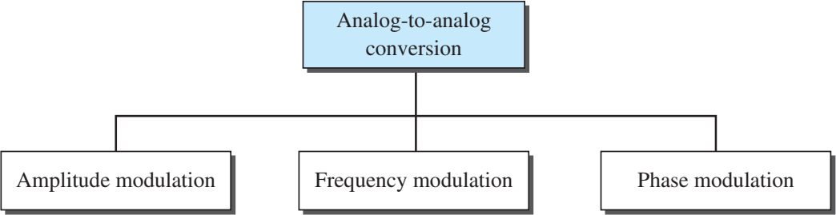
Types of analog-to-analog conversion
Data Communication Lecture Series, MFH, MAY2021

Slide 4
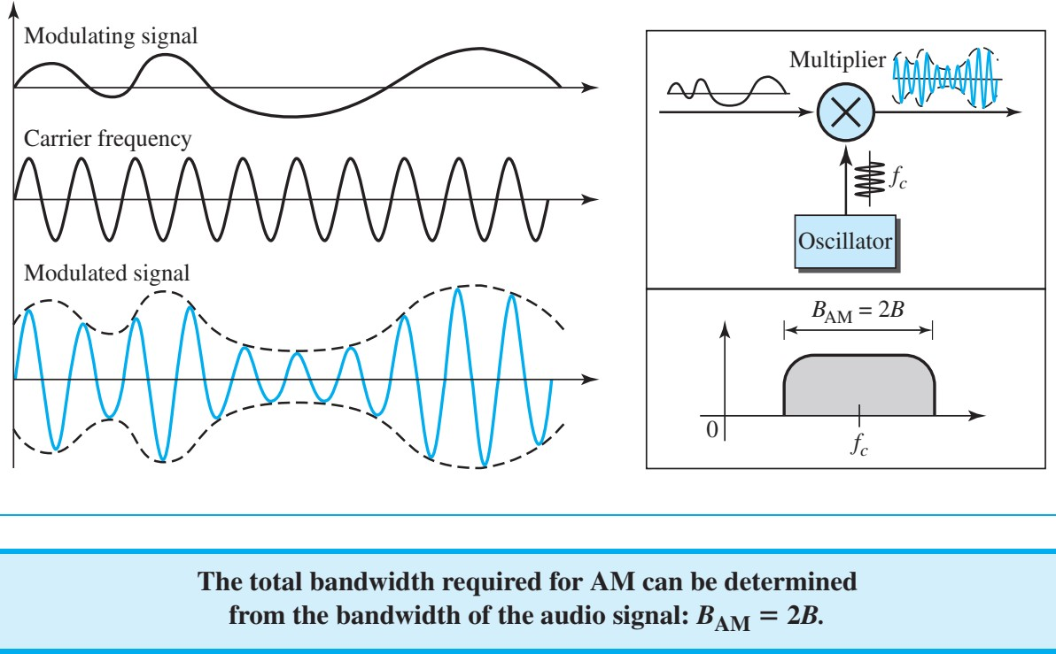
Amplitude Modulation (AM)
In AM transmission, the carrier signal is modulated so that its amplitude varies with the changing amplitudes of the modulating signal. The frequency and phase of the carrier remain the same; only the amplitude changes to follow variations in the information.
Data Communication Lecture Series, MFH, MAY2021

Slide 5
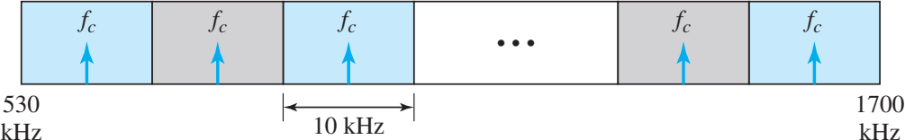
AM Band Allocation
Data Communication Lecture Series, MFH, MAY2021
5.5

Slide 6
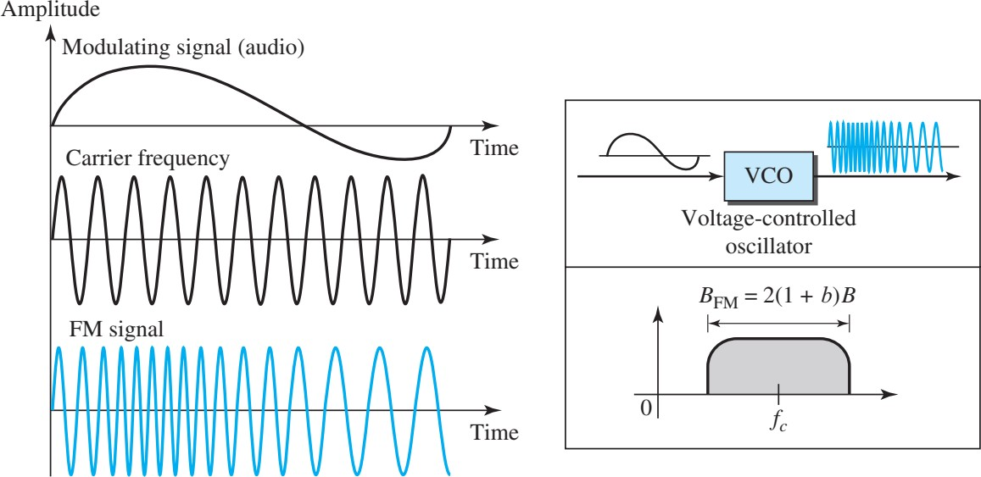

Frequency Modulation (FM)
In FM transmission, the frequency of the carrier signal is modulated to follow the changing voltage level (amplitude) of the modulating signal. The peak amplitude and phase of the carrier signal remain constant, but as the amplitude of the information signal changes, the frequency of the carrier changes correspondingly.
Data Communication Lecture Series, MFH, MAY2021
5.6

Slide 7
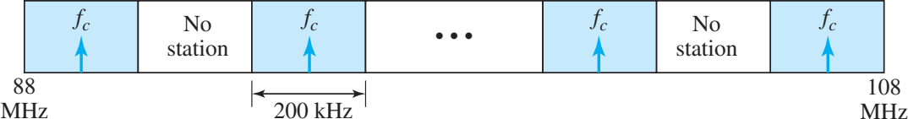
FM Band Allocation
Data Communication Lecture Series, MFH, MAY2021
5.7

Slide 8
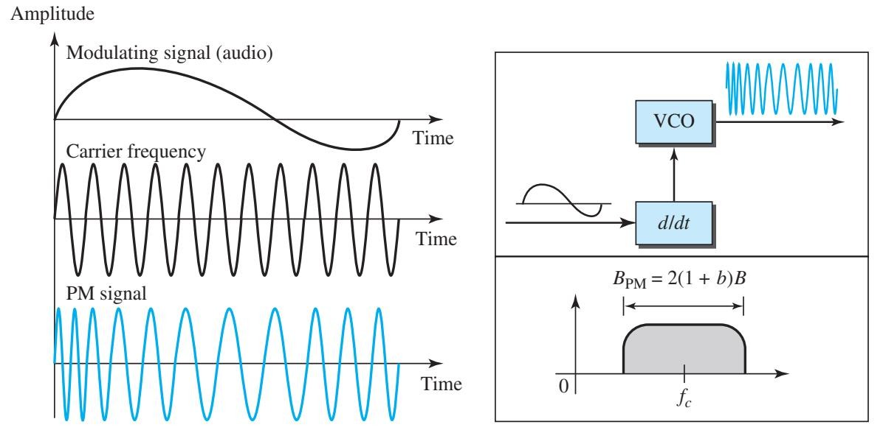

Phase Modulation (PM)
In PM transmission, the phase of the carrier signal is modulated to follow the changing voltage level (amplitude) of the modulating signal. The peak amplitude and frequency of the carrier signal remain constant, but as the amplitude of the information signal changes, the phase of the carrier changes correspondingly.
Data Communication Lecture Series, MFH, MAY2021
5.8

Slide 9


